Slide 1

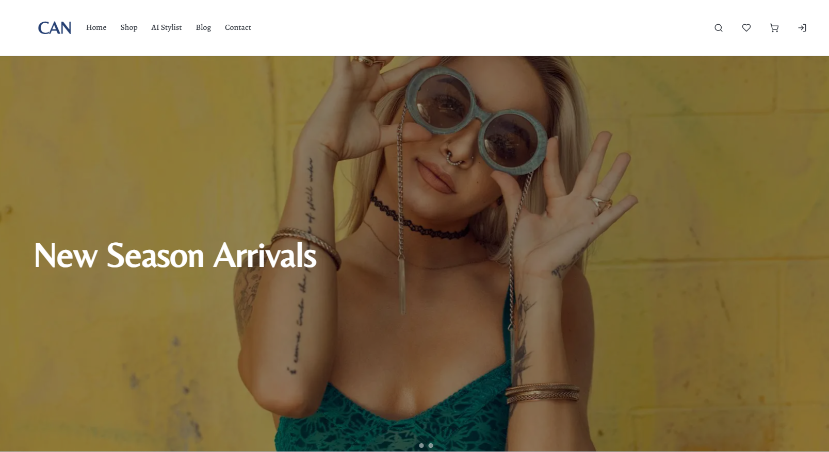
CAN : a clothing brand
Only rich people can affort.
A project by Arnob, Chironto & Najir co.

Slide 2
Project Idea Summary
What is CAN?
Core Feature
Target Users
A modern fashion e-commerce web application.
Lets users browse, search, and shop clothing products with ease.
Designed for style-conscious, mobile-first online shoppers.

Slide 3
Key Features
01
Smart Product Discovery
02
AI Stylist Recommendations
03
Wishlist & Cart Management
04
Responsive & User-Friendly Design
Browse, filter, and search products across various categories.
Get personalized outfit suggestions based on preferences.
Easily save items for later and manage your purchases.
Enjoy a seamless shopping experience on any device.

Slide 4



Used Technology :
FrontEnd
BackEnd
DataBase
Next.js (React, TypeScript), Tailwind CSS
Next.js API Routes (Node.js)
MongoDB

Slide 5
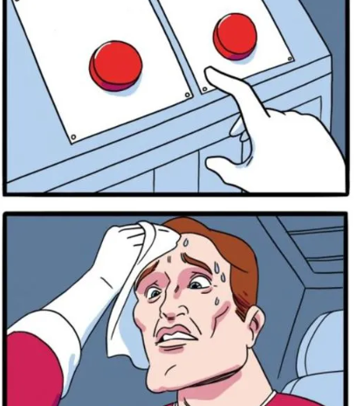
NB:
ADMIN is the DON of a business.
.
Who can Choose either লালবাত্তি or সবুজবাত্তি.

Slide 6
Admin Features
01
Smart Product Discovery
02
AI Stylist Recommendations
03
Wishlist & Cart Management
04
Responsive & User-Friendly Design
Browse, filter, and search products across various categories.
Get personalized outfit suggestions based on preferences.
Easily save items for later and manage your purchases.
Enjoy a seamless shopping experience on any device.

Slide 7
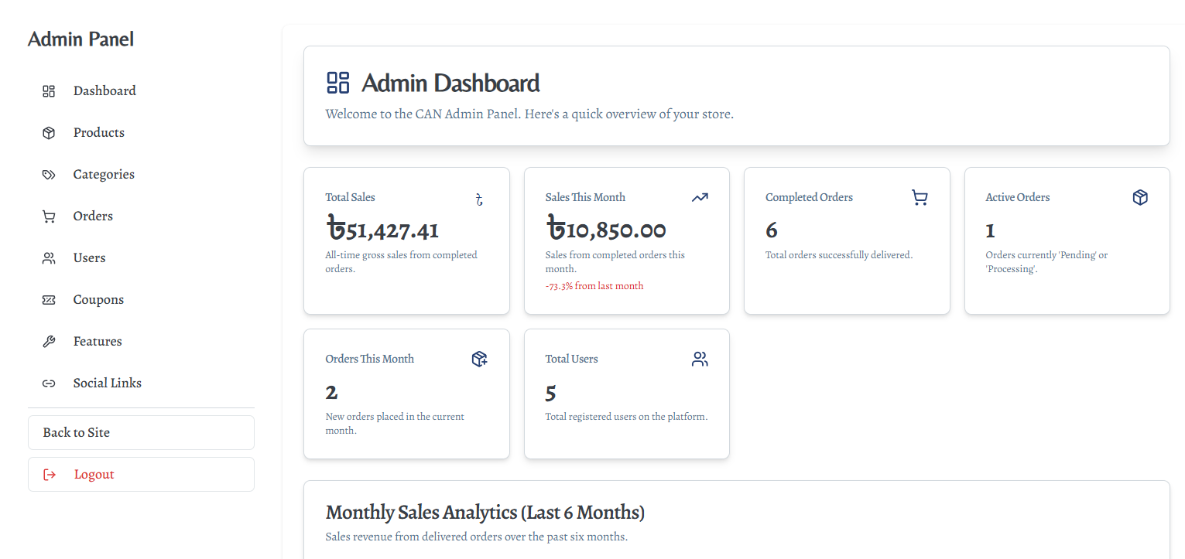
Admin features: Dashboard Overview
: View total sales, monthly sales, orders, and user stats at a glance.

Slide 8
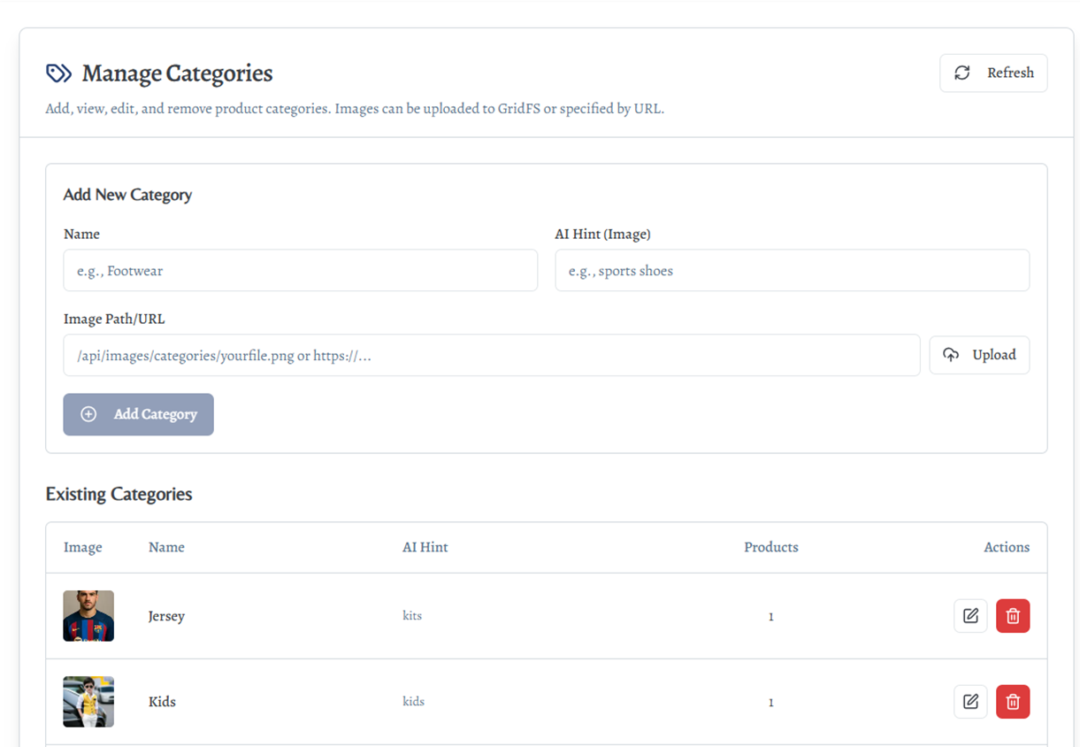
Admin features: Categories
Manage product categories for easy browsing

Slide 9
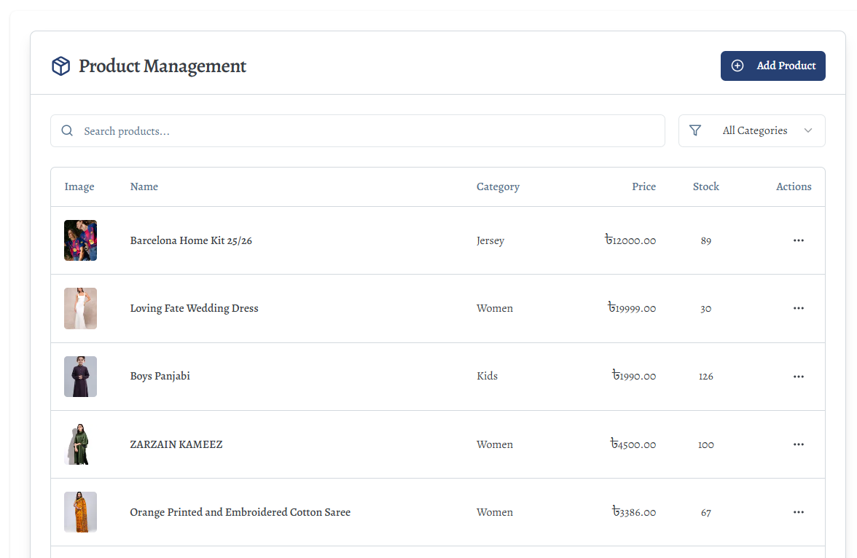
Admin features: Products
: Add, edit, or delete clothing items

Slide 10
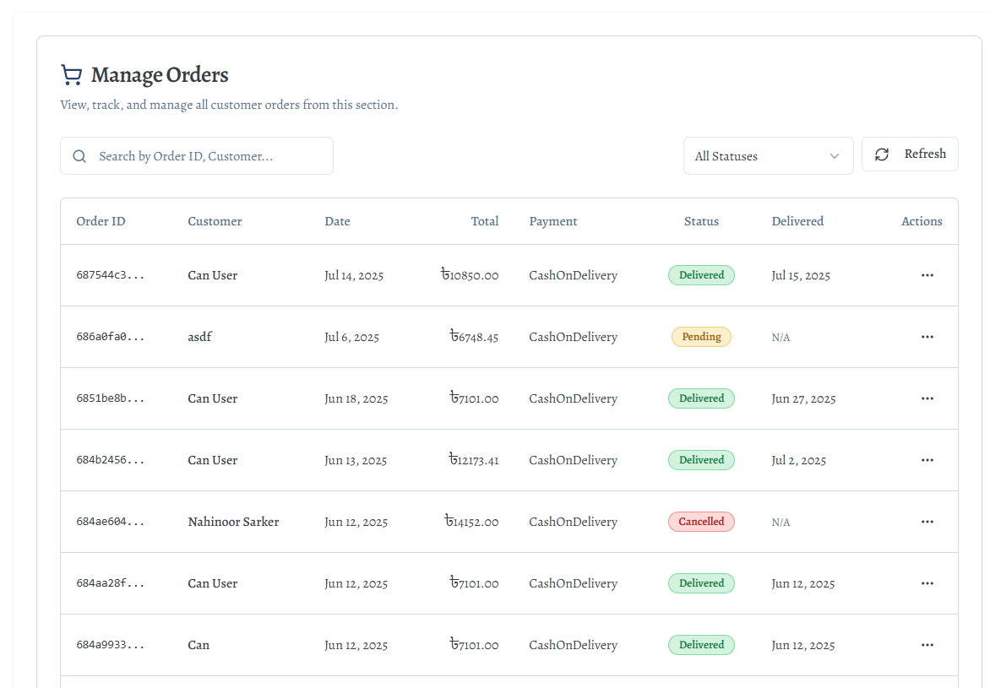
Admin features: Orders
: View and process customer orders.

Slide 11
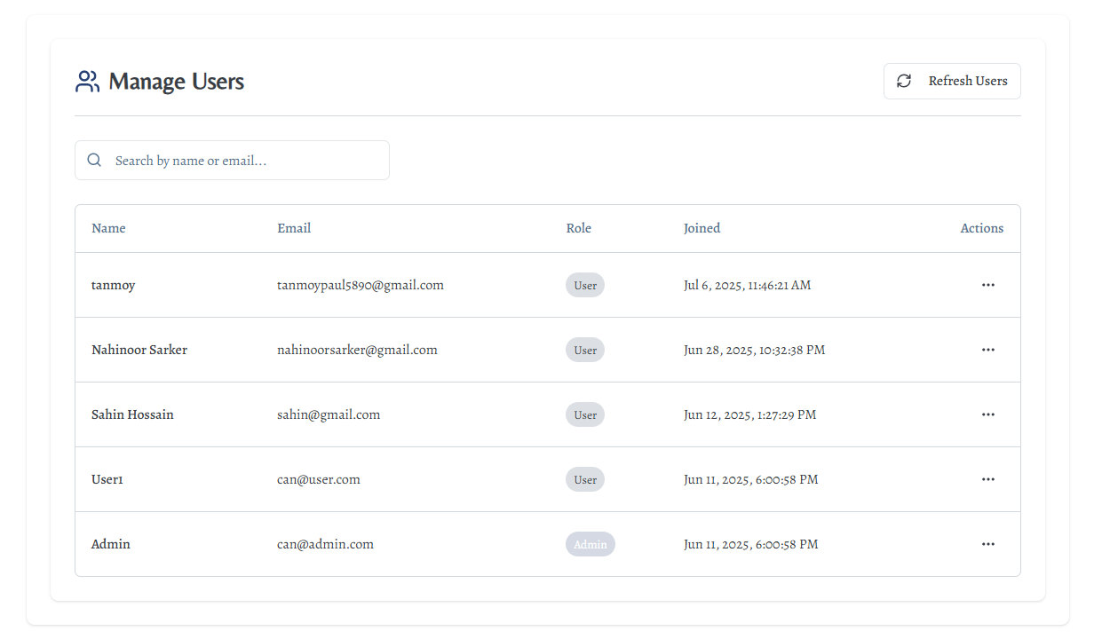
Admin features: Users
: Manage customer Account and detailes

Slide 12
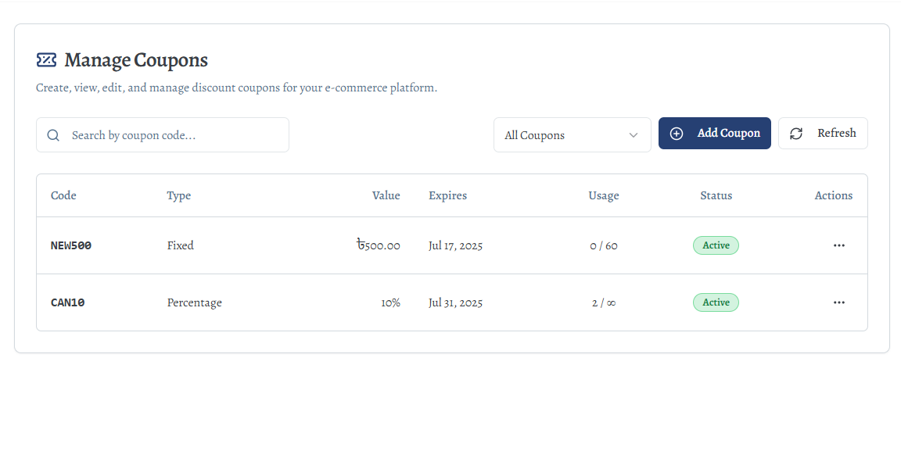
Admin features: Manage Coupons
: Create and manage discount codes

Slide 13
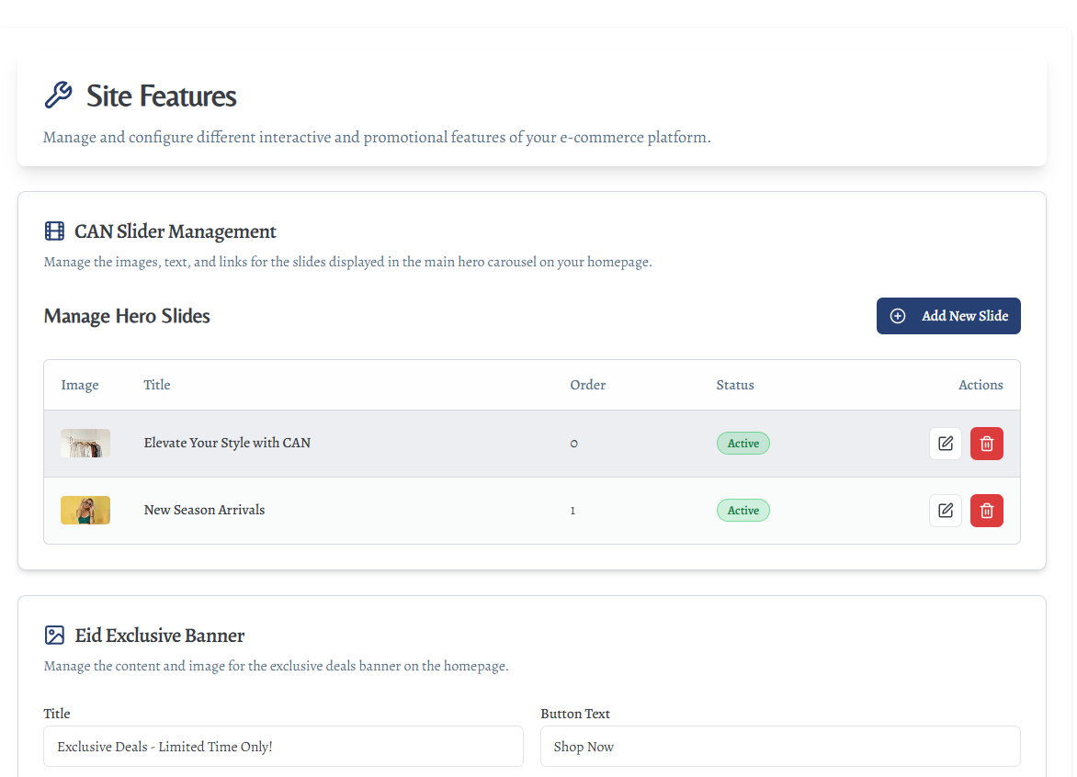
Admin features: Site Features
: Toggle and update site features.

Slide 14
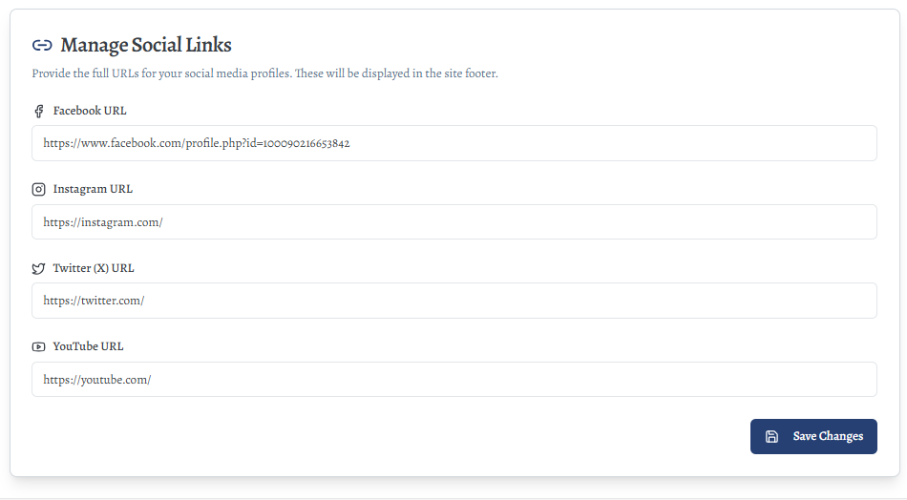
Admin features: Manage Social links
: Manage links to social media profiles

Slide 15

User Features
Only rich people can access our CAN

Slide 16

Welcome! Welcome!

Slide 17
User Features
01
Profile & Settings
02
Orders & Wishlist
Addresses
Payments
03
04
Manage user data and account preferences.
Display order history and saved items.
Handle CRUD operations for user addresses.
Securely manage stored payment methods.

Slide 18
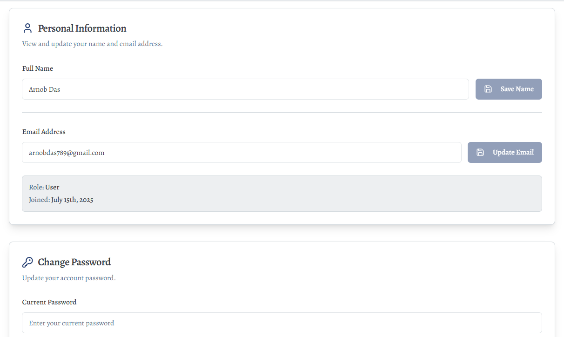
USER features: MY Profile
: Can update user profile data & change Password

Slide 19
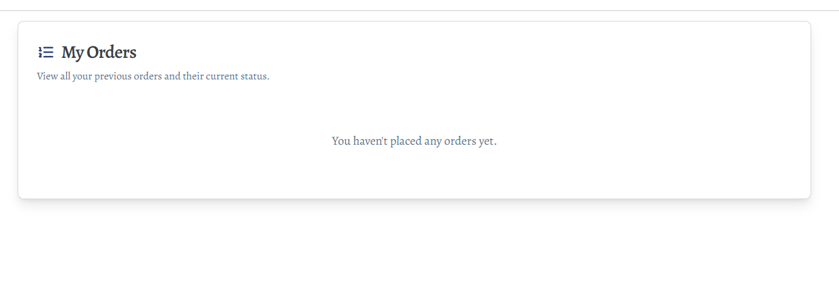
USER features: MY Order
: Fetch and display order.

Slide 20
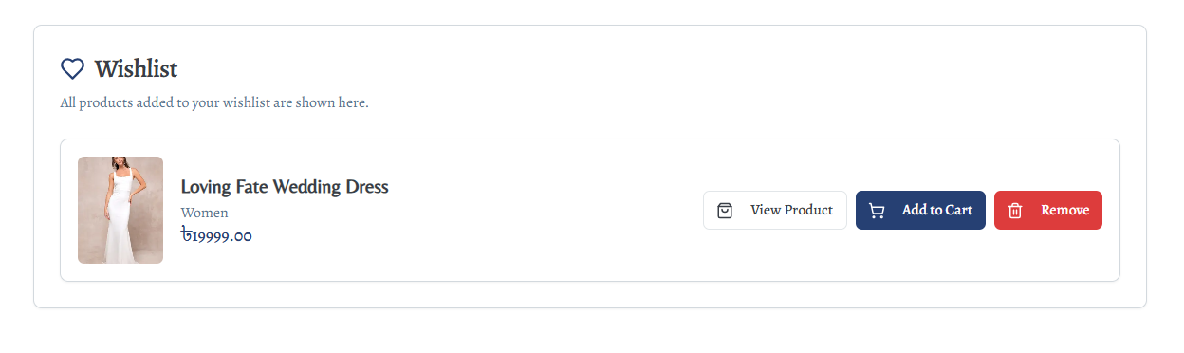
USER features: Wishlist
: Store favorite product IDs

Slide 21
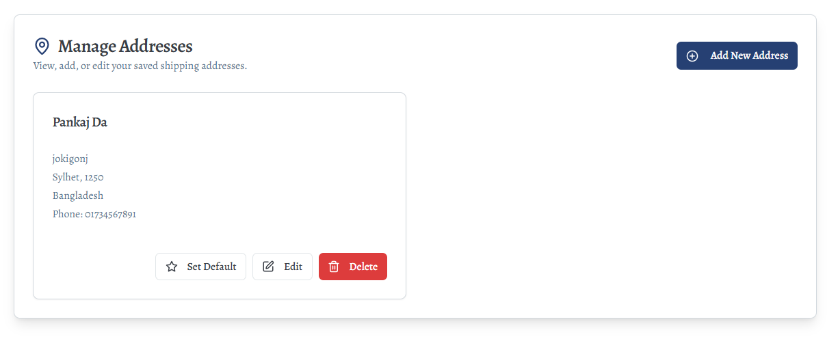
USER features: Manage Addresses
: CRUD user addresses entry.

Slide 22
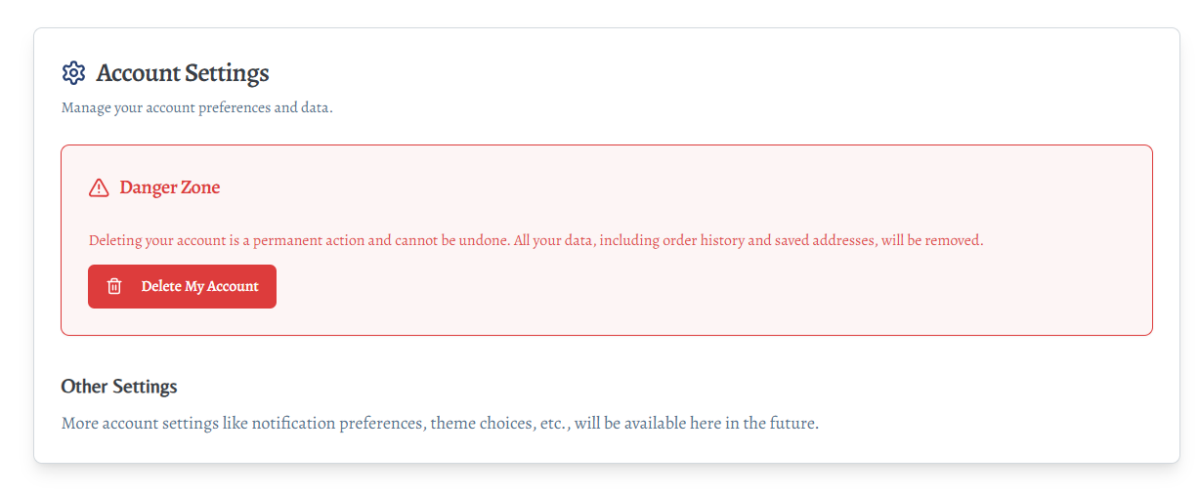
USER features: Account Settings
: Handle preferences and authentication

Slide 23

User Interface

Slide 24
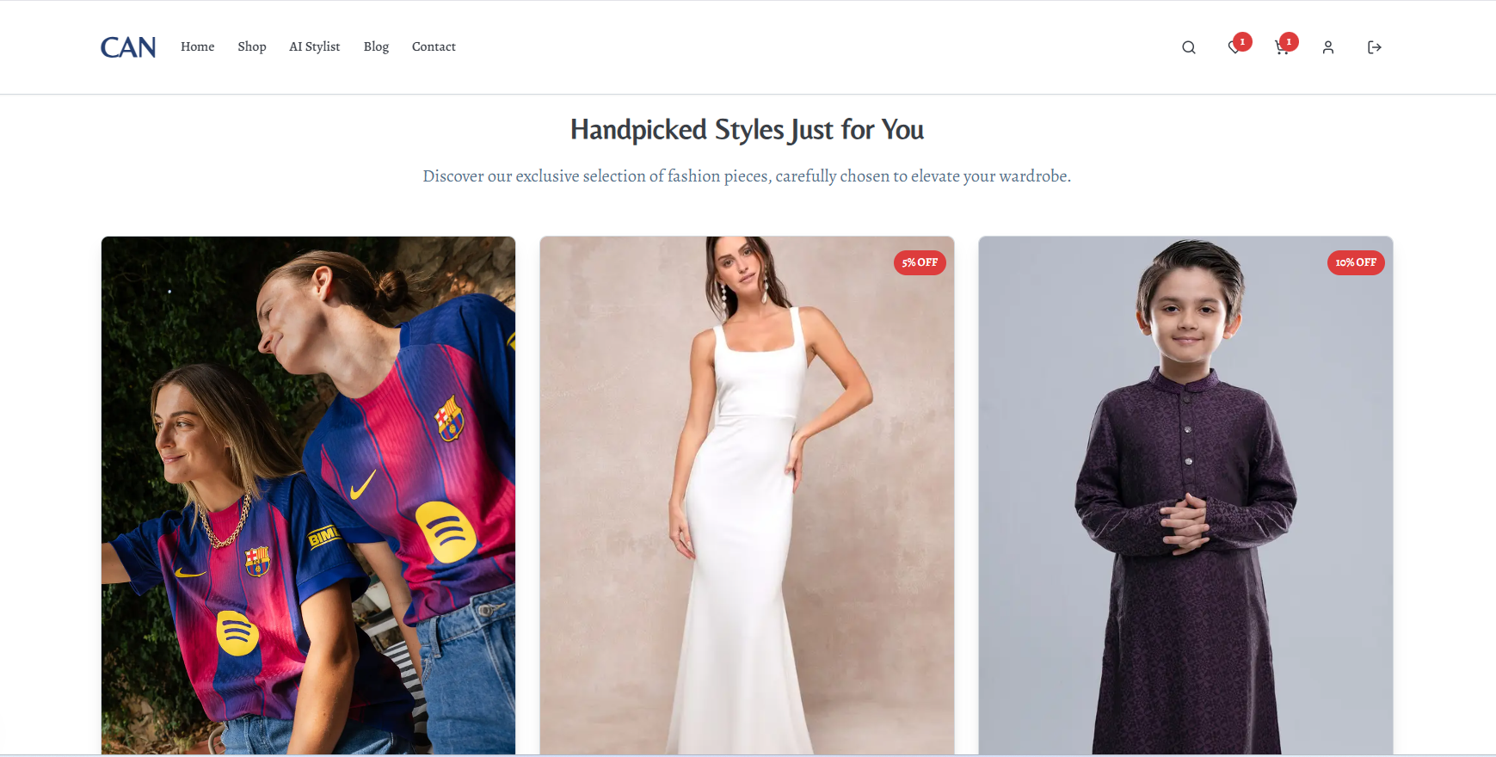

Slide 25
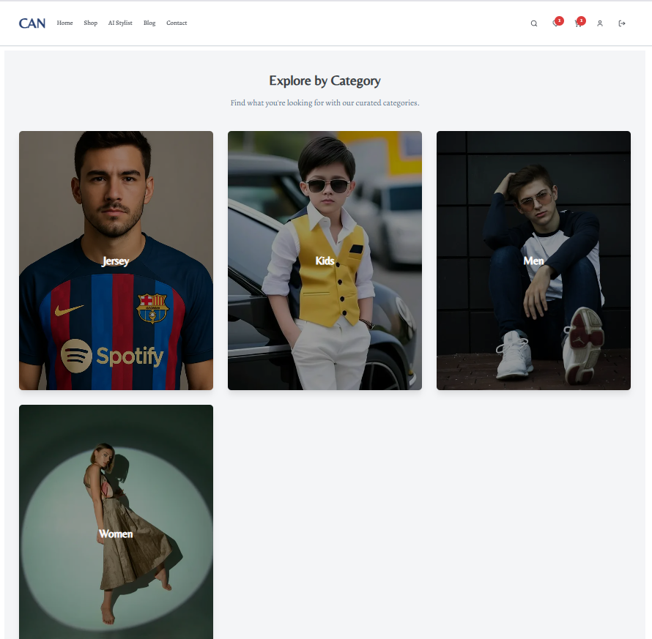

Slide 26
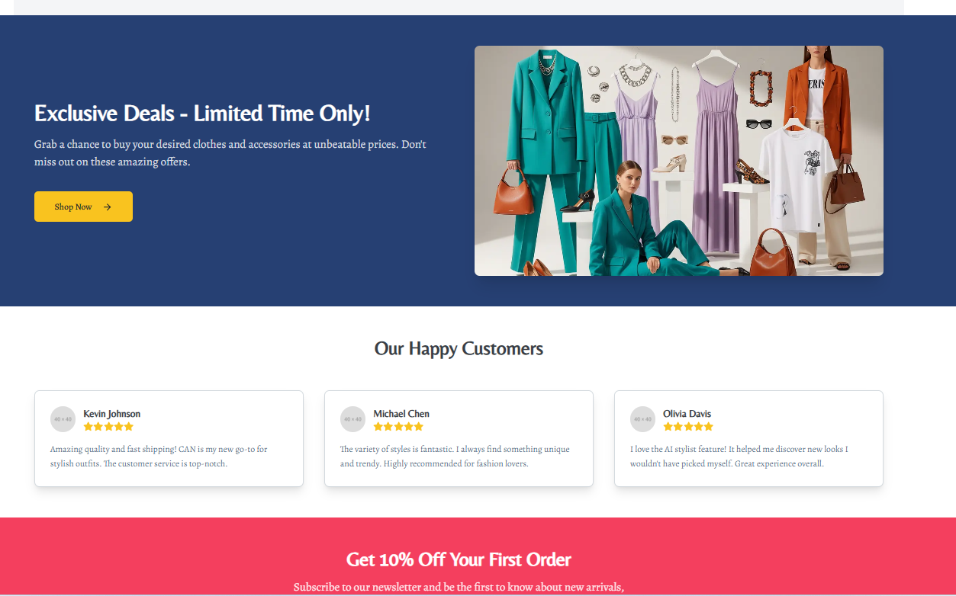

Slide 27
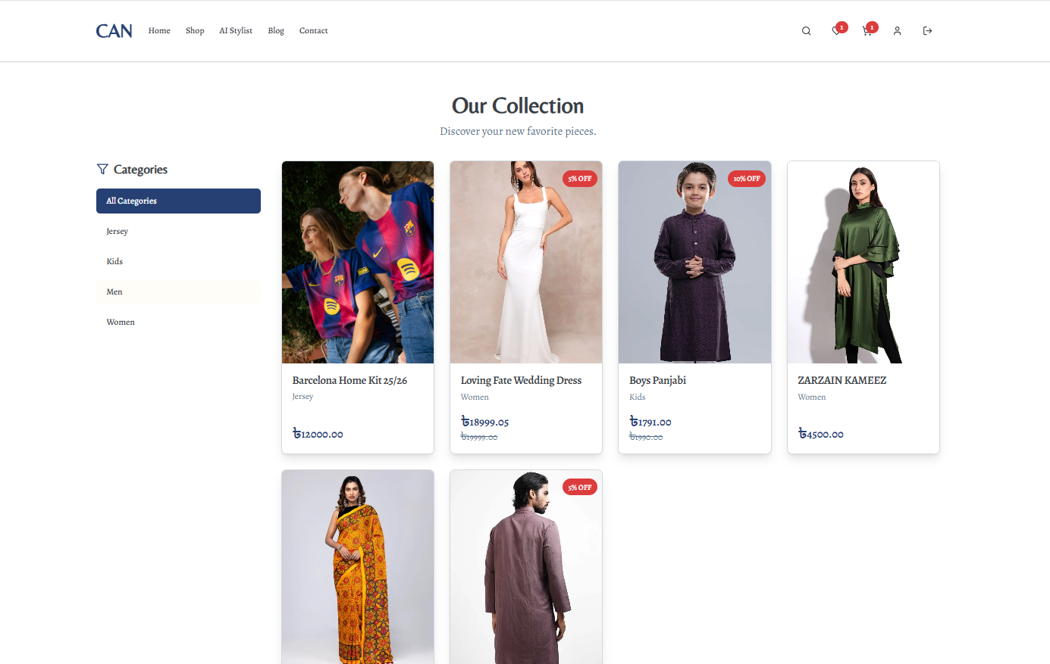

Slide 28

Special features
Why can is so special for industry?

Slide 29
Ok, Now listen a story

Slide 30

AI Stylist
- A gemini based AI fashion Suggestion

Slide 31
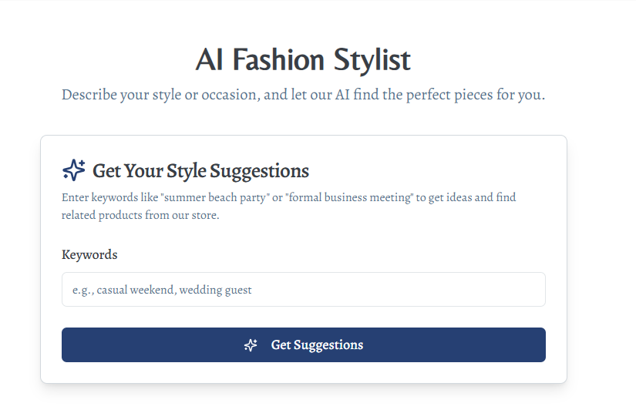

Slide 32
Our Blog page
Owner can publish blog about his brand and fashion lifestyle.

Slide 33
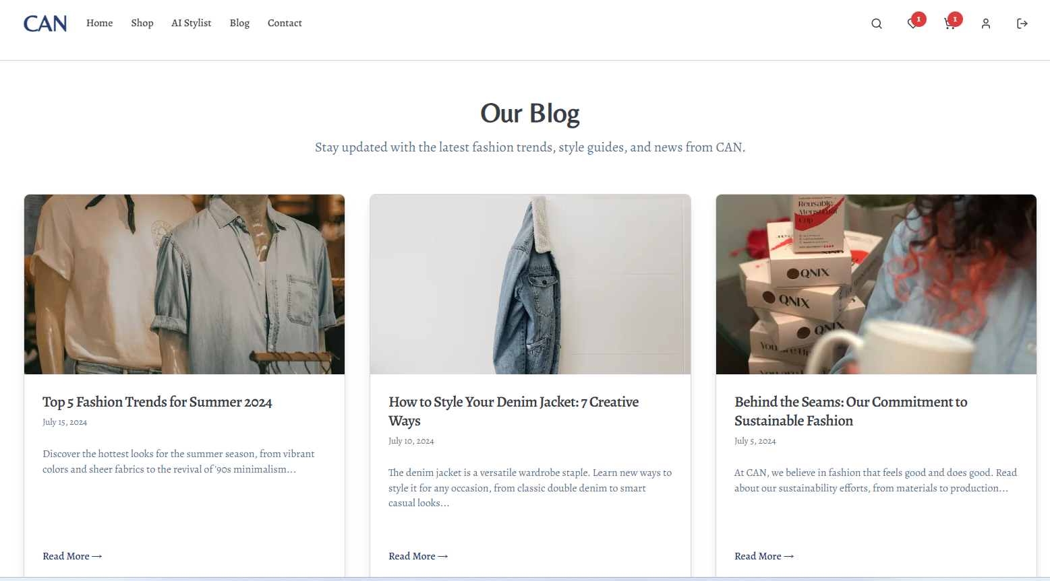

Slide 34
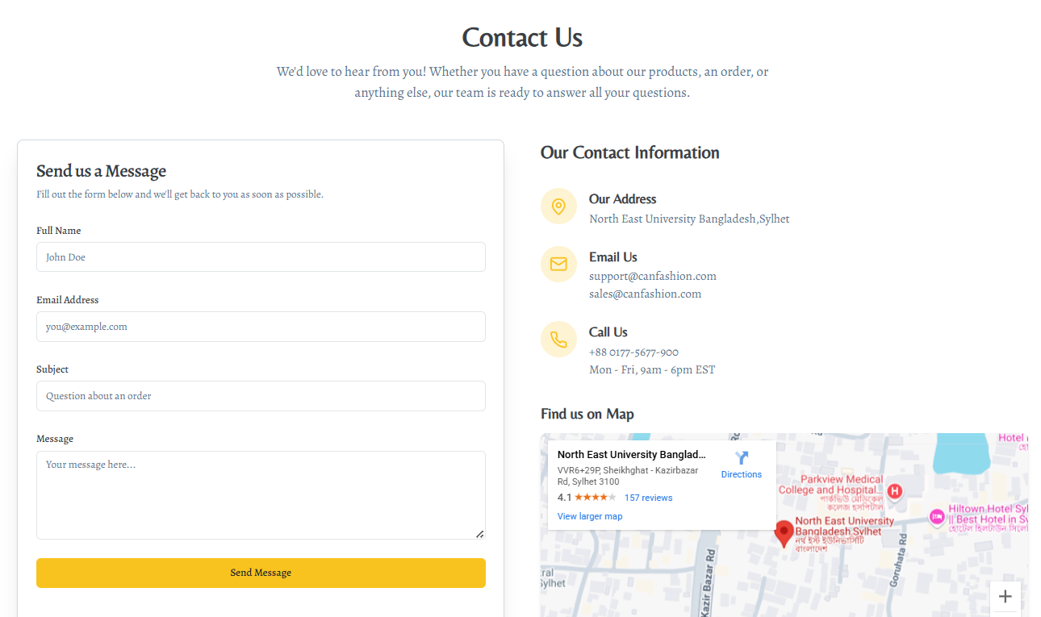
Contact Page
For Access customer services

Slide 35
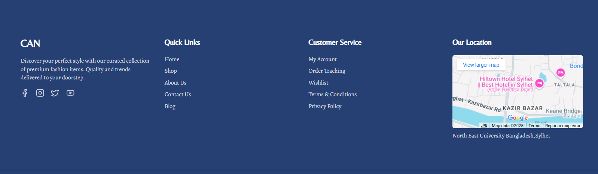
Footer
For easy way Access customer servises

Slide 36

CAN
Launch Your Store.
Scale Your Vision.
How to improve your business with CAN ?

Slide 37
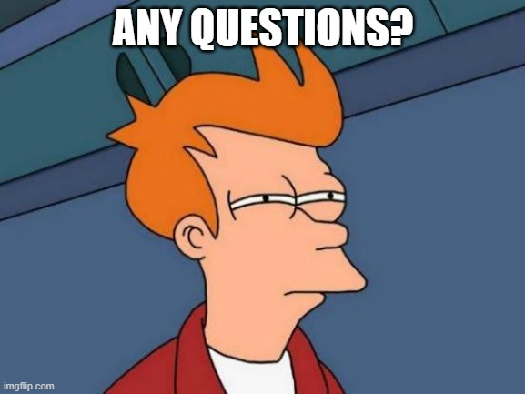
CAN
Launch Your Store.
Scale Your Vision.
Any Question?

Slide 38

Thanks!
Project Member:
Najir Hossain Shahinur
0562310005101033
ARNOB DAS
0562310005101028
Chironto Rudra Paul
0562310005101048

